Slide 1
First-Order Logic

Slide 2
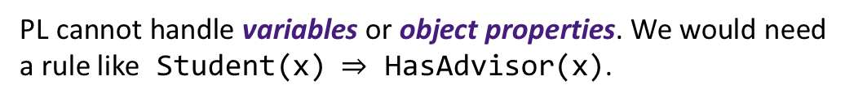
Going Beyond Propositional Logic I
We explored Propositional Logic (PL). It allowed us to represent and reason about facts that are either true or false. It is powerful for modeling simple boolean scenarios (e.g., whether a light is on or off or whether a person is present or absent), but what if we want to express more nuanced ideas:
Every student in the class submitted the assignment.
PL lacks quantifiers: ‘every’. We would need a separate proposition for each student (e.g., Submitted_Alice, Submitted_Bob). This does not scale or generalize.
Some professors teach multiple courses.
PL cannot represent relationships between objects (e.g., professors and courses). We need a predicate like Teaches(ProfX, CourseY).
If a person is a student, then they have an advisor.
PL cannot handle variables or object properties. We would need a rule like Student(x) $⇒$ HasAdvisor(x).

Slide 3
First-Order Logic
First-Order Logic (FOL) is a formal system for representing knowledge and reasoning about objects, their properties, and relationships between them.
Properties
Capabilities
More expressive than propositional logic
Uses variables, predicates, and quantifiers
Foundation for knowledge representation in AI
Enables reasoning about infinite domains
First-Order Logic is sometimes refered to as Predicate Logic or Predicate Calculus.

Slide 4

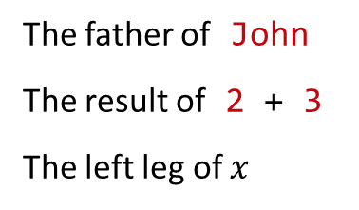
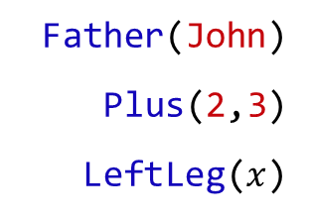
Syntax: Terms
Definition. A term represents an object in the domain.
Types
Examples
Constants: specific objects
John, 42, Alice, 2, Madison, Green
Variables: placeholders for objects
$x$, $y$, $person$, $number$
Father(John)
Plus(2,3)
LeftLeg($x$)
The father of John
The result of 2 + 3
The left leg of $x$
Functions: computed objects (map objects to objects)
Definition. A ground term is a term with no variables.

Slide 5

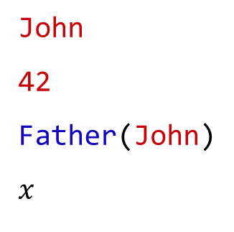
Terms vs Sentences
Terms
Sentences
Sentences make claims that can be evaluated as true / false.
Refer to objects in the domain:
John
42
Father(John)
$$x$$
a specific person
a specific number
John’s father (a person)
any object (placeholder)
Student(Alice)
Tall(John)
Loves(Jesse, Jordan)
Is Alice a student?
Is John tall?
Does Jesse love Jordan?
Does every student have a laptop?
$∀x$ Student($x$) $⇒$ HasLaptop($x$)
Terms are not true or false, they just name objects
Sentences are true / false: they make assertions.
Father(John)
refers to someone.
Tall(Father(John))
claims something.

Slide 6

Distinguishing Functions from Predicates
In FOL, predicates and functions use the same syntax (Symbol(arg₁, arg₂, ...)), creating potential ambiguity: Father(John) might be a function (term) or predicate (sentence) depending on how Father is defined, whereas IsFather(John) is clearly a predicate.
Context and declaration are needed to disambiguate.
Function
Predicate
Father(John)
Returns John's father.
IsFather(John)
Is John a father?
Tall(Father(John))
Is the father of John tall?
IsFather(John)$∧$ Doctor(John)
Compound claim: Is John a father and is John a doctor?
  Note, functions appear inside predicates:
  Tall(Father(John))
Is Father(John) ∧ Doctor(John) a valid compound sentence?
  No. Father(John) is not a sentence.
  You might write: $∃x$ ($x=$ Father(John) ∧ Doctor($x$))

Slide 7
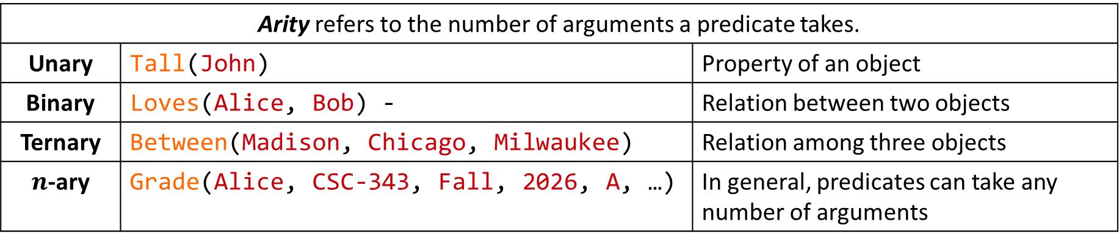
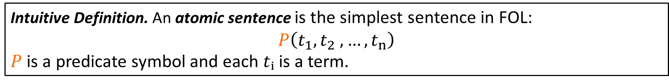

Syntax: Atomic Sentences
Intuitive Definition. An atomic sentence is the simplest sentence in FOL:
$$P\left(t_{1},t_{2} , …,t_{n}\right)$$
$P$ is a predicate symbol and each $tᵢ$ is a term.
Atomic sentences make a single assertion without logical connectives (∧, ∨, ¬, $⇒$) or quantifiers ($∀$, $∃$), and can be evaluated as true or false.
Why can $P$ not be a function?
Arity refers to the number of arguments a predicate takes.
Unary | Tall(John) | Property of an object
Binary | Loves(Alice, Bob) - | Relation between two objects
Ternary | Between(Madison, Chicago, Milwaukee) | Relation among three objects
$n$-ary | Grade(Alice, CSC-343, Fall, 2026, A, …) | In general, predicates can take any number of arguments

Slide 8

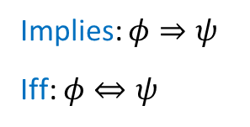
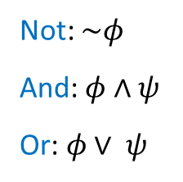



Syntax: Complex Sentences (Quantifiers)
  Not: $\sim φ$
  And: $φ∧ψ$
  Or: $φ∨ ψ$
  Implies: $φ⇒ψ$
  Iff: $φ⇔ψ$
Logical Connectives (same interpretation as with propositional logic)
Quantified Statements
  Universal ($∀$): Statement holds for all objects
  Existential ($∃$): Statement holds for at least one object
  $$∀x Student\left(x\right)⇒HasLaptop\left(x\right)$$
  $$∃x Student\left(x\right)∧GPA\left(x, 4.0\right)$$
  All students have a laptop.
  Some student has a 4.0 GPA
  $$∃x Student\left(x\right)∧Equals\left(GPA\left(x\right), 4.0\right)$$
  $$∀x CS_Major\left(x\right)⇒Take\left(x,CSC_223\right)$$
  Some student has a 4.0 GPA
  All CS majors must take CSC-223.
  $$∃x Student\left(John, x\right)∧Doctor\left(x\right)$$
  John has a parent who is a doctor.

Slide 9
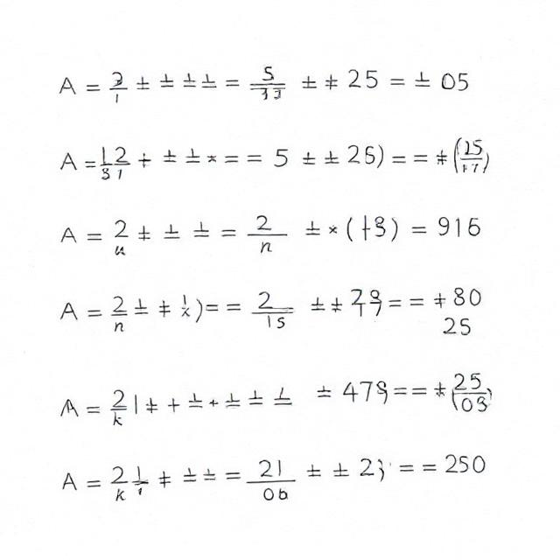




Syntax: Mixed Quantifiers
Order matters!
We assume a domain where $x$ ranges over students, $y$ ranges over courses.
  $$∀x ∃y Enrolled\left(x,y\right)$$
Every student is enrolled in some course.
  For each $x$, we can choose a different $y$
  For all students…
(Each student can be in a different course.)
  $$∃y ∀x Enrolled\left(x,y\right)$$
There's a course that every student is enrolled in.
  This same $y$ must work for all $x$
  There exists a course…
(One specific course contains all students.)

Slide 10


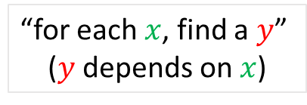





Syntax: Mixed Quantifiers II
$$∀x ∃y Loves(x, y)$$
$$∃y ∀x Loves(x, y)$$
“Everyone loves someone”
“Someone is loved by everyone”
(Each person loves at least one person; could be different people.)
(There is one specific person that everyone loves.)
Read mixed quantifiers left to right, thinking about dependency:
$$∀x ∃y$$
“for each $x$, find a $y$”
($y$ depends on $x$)
$$∃y ∀x$$
“find one $y$ that works for all $x$”
The $y$ can be different for each $x$.
The $y$ must be the same for all $x$.

Slide 11
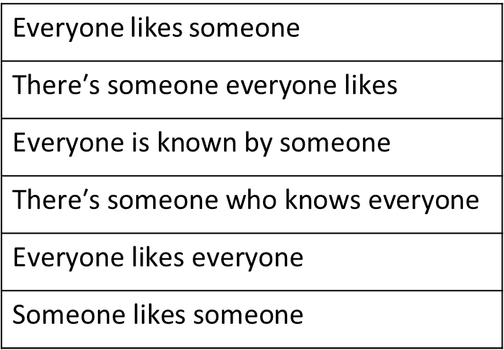
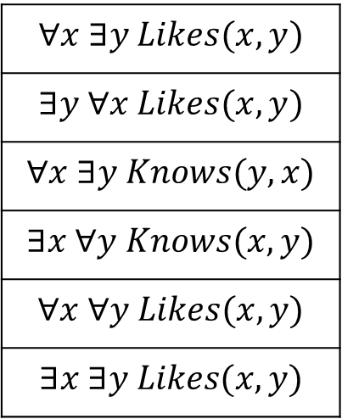
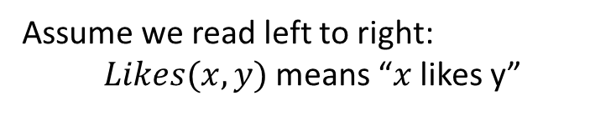
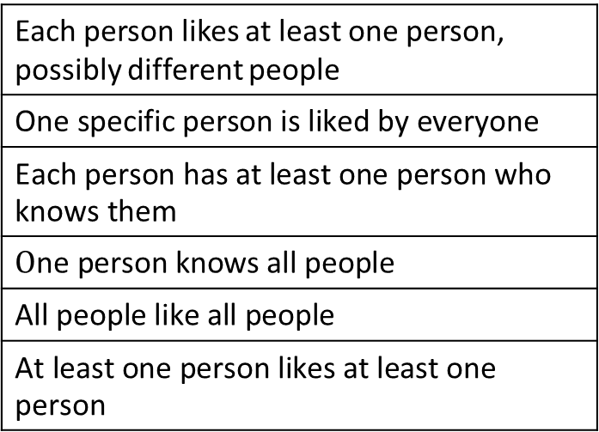
Question
Translate each FOL sentence to natural English; Domain: People.
$$∀x ∃y Likes(x, y)$$
$$∃y ∀x Likes(x, y)$$
$$∀x ∃y Knows(y, x)$$
$$∃x ∀y Knows(x, y)$$
$$∀x ∀y Likes(x, y)$$
$$∃x ∃y Likes(x, y)$$
Everyone likes someone
$$\text{There}\text{′}\text{s} \text{someone} \text{everyone} \text{likes}$$
$$\text{Everyone} \text{is} \text{known} \text{by} \text{someone}$$
$$\text{There}\text{′}\text{s} \text{someone} \text{who} \text{knows} \text{everyone}$$
$$\text{Everyone} \text{likes} \text{everyone}$$
$$\text{Someone} \text{likes} \text{someone}$$
Each person likes at least one person, possibly different people
$$\text{One} \text{specific} \text{person} \text{is} \text{liked} \text{by} \text{everyone}$$
$$\text{Each} \text{person} \text{has} \text{at} \text{least} \text{one} \text{person} \text{who} \text{knows} \text{them}$$
$$\text{O}\text{ne} \text{person} \text{knows} \text{all} \text{people}$$
$$\text{A}\text{ll} \text{people} \text{like} \text{all} \text{people}$$
$$\text{A}\text{t} \text{least} \text{one} \text{person} \text{likes} \text{at} \text{least} \text{one} \text{person}$$
Assume we read left to right:
$Likes(x, y)$ means “$x$ likes y”

Slide 12

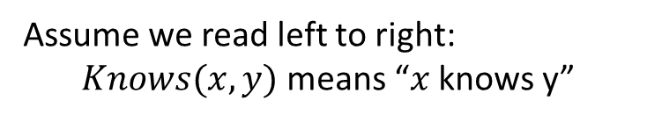
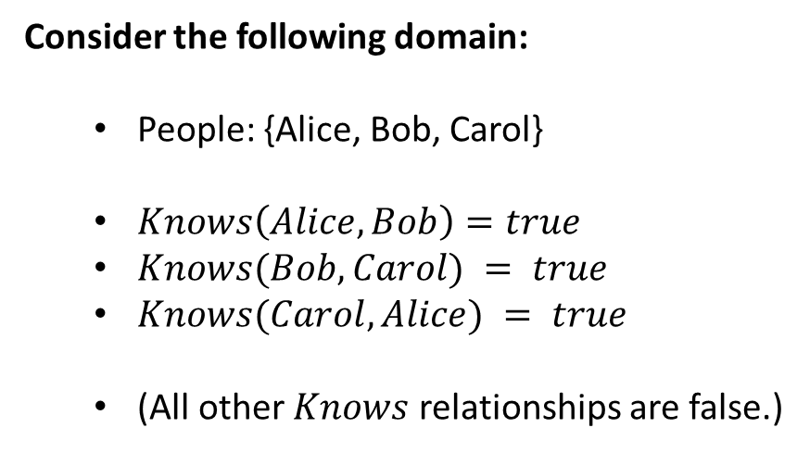



Question
$$∀x ∃y Knows(x, y)$$
True
Consider the following domain:
  People: {Alice, Bob, Carol}
  $Knows\left(Alice, Bob\right)=true$
  $Knows(Bob, Carol) = true$
  $Knows(Carol, Alice) = true$
  (All other $Knows$ relationships are false.)
Every person knows at least one other person.
$$∃y ∀x Knows(x, y)$$
False
There is no single person that everyone knows.
$$∀x ∃y Knows(y, x)$$
True
Assume we read left to right:
$Knows(x, y)$ means “$x$ knows y”
Everyone is known by someone.
$$∃x ∀y Knows(x, y)$$
False
Evaluate each statement as true or false.
There is no person who knows everyone.

Slide 13

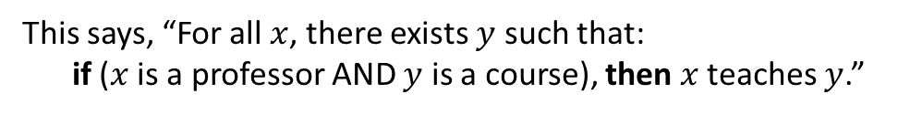
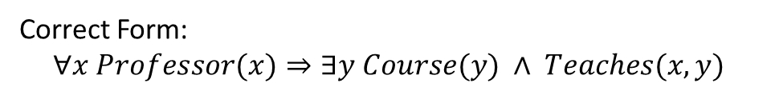
Question
Each sentence below has an error in the FOL translation. Identify and fix it:
Every student has an advisor who advises them.
$$∃x Student(x)⇒∃y Advisor(y) ∧ Advises(y, x)$$
Uses $∃x$ instead of $∀x$.
Every professor teaches at least one course.
$$∀x ∃y Professor(x) ∧ Course(y)⇒Teaches(x, y)$$
This says, “For all $x$, there exists $y$ such that:
if ($x$ is a professor AND $y$ is a course), then $x$ teaches $y$.”
Implications are of the form
If [condition], then [consequence]
Correct Form:
$$∀x Professor(x)⇒∃y Course(y) ∧ Teaches(x, y)$$

Slide 14
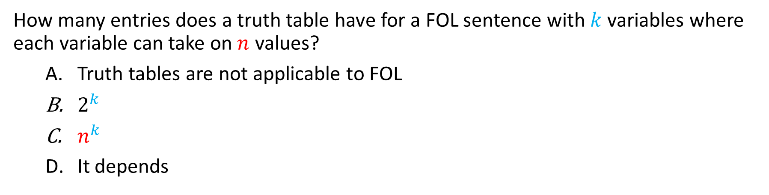
Question
How many entries does a truth table have for a FOL sentence with $k$ variables where each variable can take on $n$ values?
  Truth tables are not applicable to FOL
  $2^{k}$
  $n^{k}$
  It depends
A. Truth tables do not work for FOL because the domain can be infinite, and we need to consider all possible interpretations of predicates and functions, not just variable assignments.

Slide 15
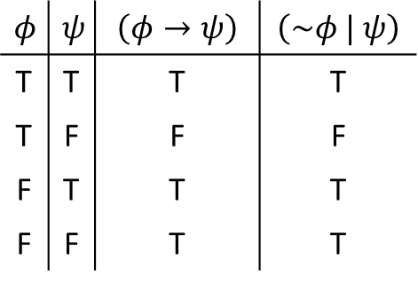







Quantifiers: Important Patterns
Universal ($∀$) typically uses implication ($⇒$)
$$∀x Student(x) ⇒ Smart(x)$$
$$∀x Student(x) ∧ Smart(x)$$
“All students are smart”
“Everything is both a student and smart”
Existential ($∃$) typically uses conjunction ($∧$)
$$∃x Student(x) ∧ Smart(x)$$
$$∃x Student(x) ⇒ Smart(x)$$
“Some student is smart”
True if anything is not a student!
$$≡∃x\left(\sim Student\left(x\right)∨Smart(x)\right)$$

Slide 16
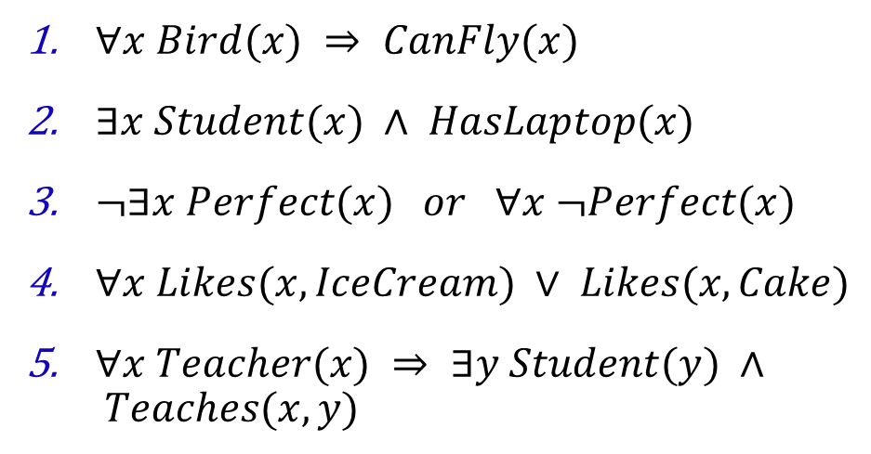
Question
Translate to FOL.
  “All birds can fly”
  “Some students have laptops”
  “No one is perfect”
  “Everyone likes ice cream or cake”
  “If someone is a teacher, then they have students”
  $∀x Bird(x) ⇒ CanFly(x)$
  $∃x Student(x) ∧ HasLaptop(x)$
  $¬∃x Perfect(x) or ∀x ¬Perfect(x)$
  $∀x Likes(x, IceCream) ∨ Likes(x, Cake)$
  $∀x Teacher(x) ⇒ ∃y Student(y) ∧ Teaches(x, y)$

Slide 17
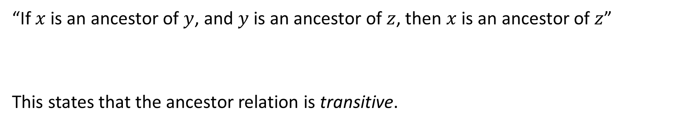
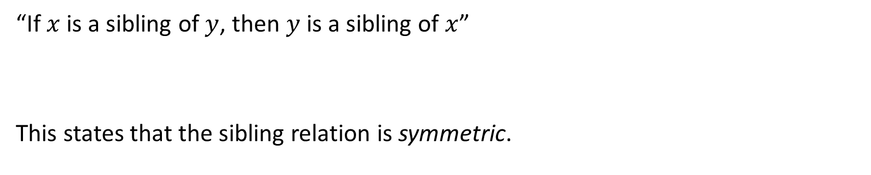
Symmetry and Transitivity
“If $x$ is a sibling of $y$, then $y$ is a sibling of $x$”
This states that the sibling relation is symmetric.
$$∀x ∀y Sibling(x, y) ⇒ Sibling(y, x)$$
“If $x$ is an ancestor of $y$, and $y$ is an ancestor of $z$, then $x$ is an ancestor of $z$”
This states that the ancestor relation is transitive.
$$∀x ∀y ∀z (Ancestor(x, y) ∧ Ancestor(y, z)) ⇒ Ancestor(x, z)$$

Slide 18
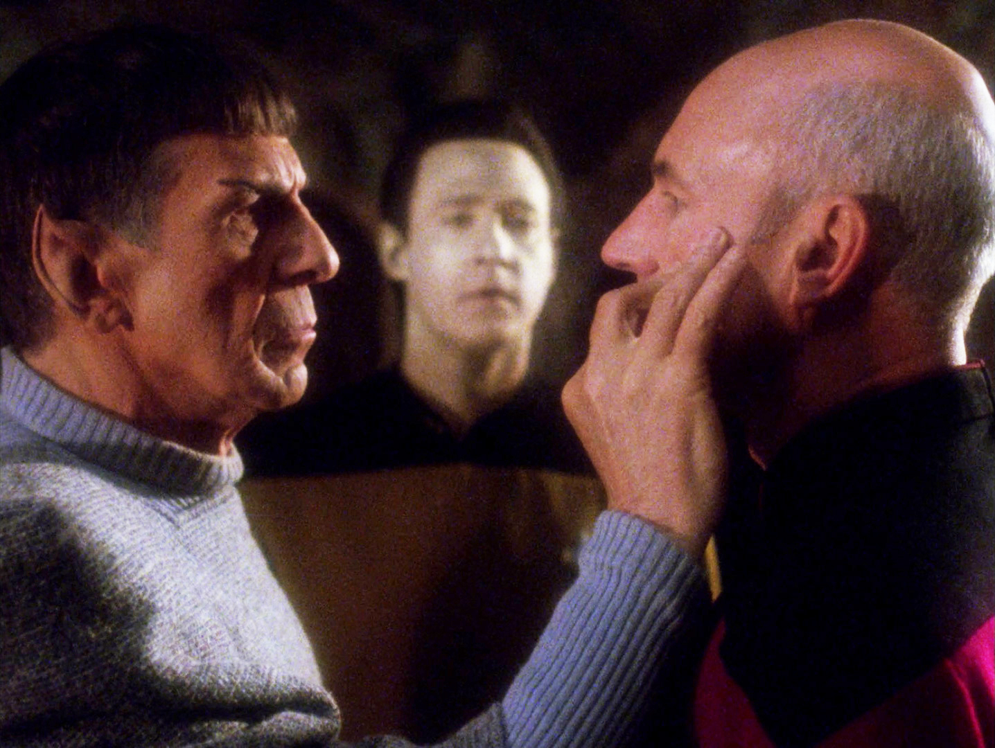
Unification

Slide 19
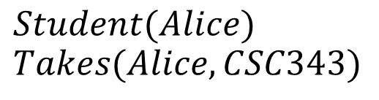
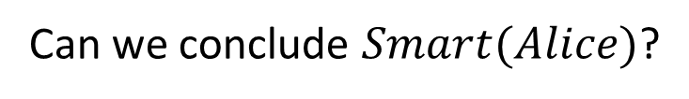
Unification: Matching Rules to Facts
We have facts in our knowledge base:
  $$Student(Alice)$$
  $$Takes(Alice, CSC343)$$
We have general rules:
  $$∀x (Student(x) ∧ Takes(x, CSC343)) ⇒ Smart(x)$$
Can we conclude $Smart(Alice)$?

Slide 20




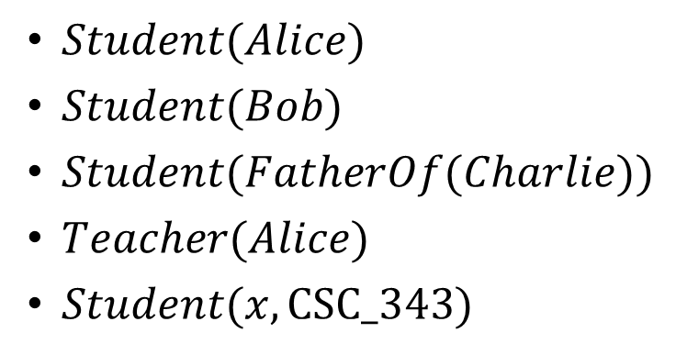
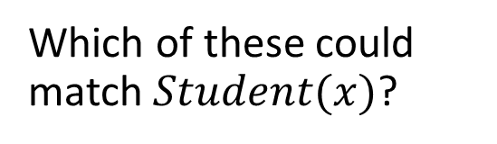
Unification: Matching Rules to Facts II
The challenge is that variables in rules can match any term
$Student(Alice)$
$Student(Bob)$
$Student(FatherOf(Charlie))$
$Teacher(Alice)$
$Student(x, CSC_343)$
Which of these could match $Student(x)$?
Different predicate
Different arity
We need a systematic way to:
  Find what value(s) make expressions match
  Apply those values consistently throughout reasoning
  Handle complex nested terms
Unification to the rescue!

Slide 21




Unification: The Main Idea
Unification finds substitutions that make expressions identical.
Rules
$$Likes(Alice, x)$$
Facts
$$Likes(Alice, Pizza)$$
What should $x$ be?
$$x = Pizza$$
Goal: Make two expressions match by finding substitutions for variables.
Unification enables automated reasoning by systematically matching facts with rules so we can apply inference in FOL and power systems like Prolog.
Once we can unify, we can automate logical reasoning!

Slide 22
Unification Examples
Example: Multiple variables
Sibling(x, y)
Sibling(John, Mary)
Example: Variables on both sides
Parent(x, Bob)
Parent(Alice, y)
Unifier: { x/John, y/Mary }
Unifier: {x/Alice, y/Bob}
Example: Nested Terms
Ancestor(FatherOf(x), y)
Ancestor(FatherOf(John), Mary)
Example: Functions Unifying with Variables
Age(x)
Age(MotherOf(Alice))
Unifier: { x/John, y/Mary }
Unifier: { x/ MotherOf(Alice)) }

Slide 23

When Unification Fails
Example: Different Constants
Student(Alice)
Student(Bob)
Example: Variables on both sides
Student(x)
Teacher(x)
Cannot Unify: Alice$≠$Bob
Cannot Unify: Different Predicates
Example: Occurs Check
x
f(x)
The occurs check prevents infinite substitutions.
If we unify x with f(x) to acquire the substitution { x / f(x)} (that is, x <- f(x)), then whenever we need to use the value of x, we replace it with f(x).
Cannot unify! x appears inside f(x).
x <- f(x)
x <- f(f(x))
x <- f(f(f(x)))
I think this is confusing notation.

Slide 24

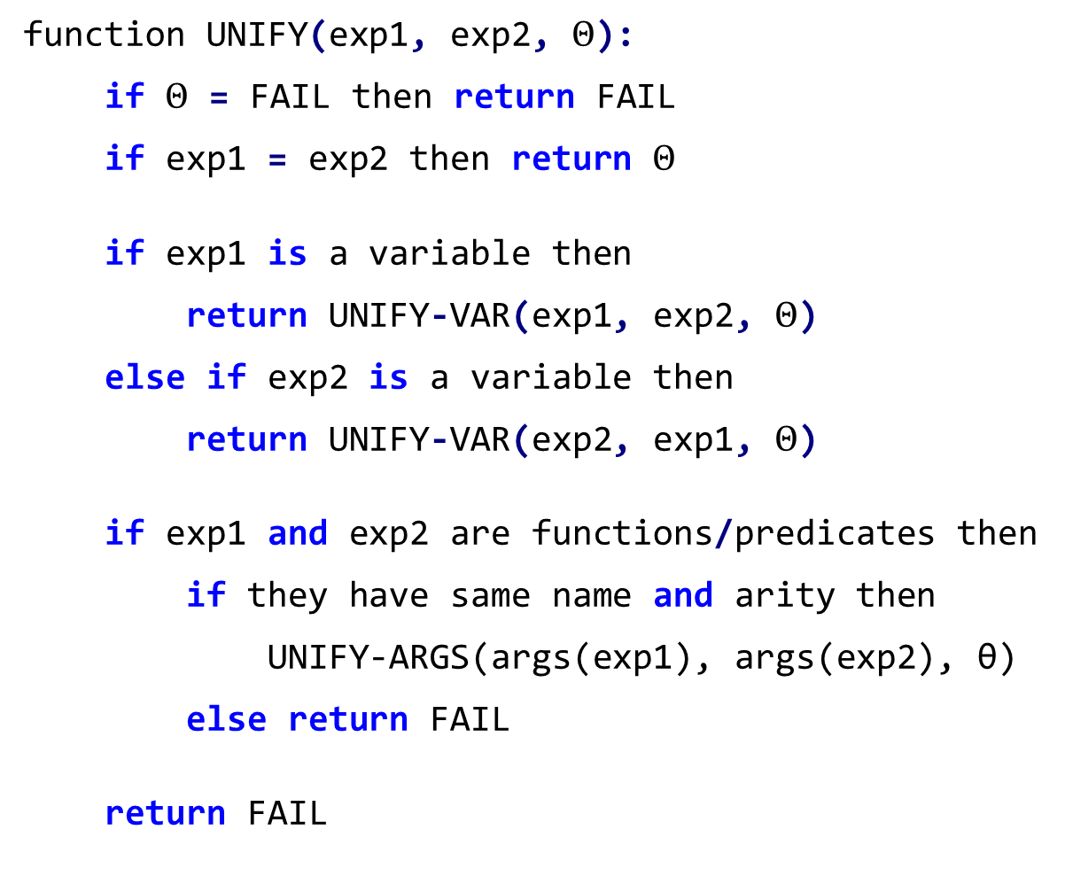
Unification Algorithm
function UNIFY(exp1, exp2, $Θ$):
if $Θ$ = FAIL then return FAIL
if exp1 = exp2 then return $Θ$
if exp1 is a variable then
return UNIFY-VAR(exp1, exp2, $Θ$)
else if exp2 is a variable then
return UNIFY-VAR(exp2, exp1, $Θ$)
if exp1 and exp2 are functions/predicates then
if they have same name and arity then
UNIFY-ARGS(args(exp1), args(exp2), θ)
else return FAIL
return FAIL
# $Θ$ is a list of substitutions
# If already failed, propagate failure
# Identical expressions need no substitutions
# Handle either expression being variables
# Handle compound expressions
# Unify all arguments pairwise
# Different functions or arity
# Cannot unify: no other cases match

Slide 25
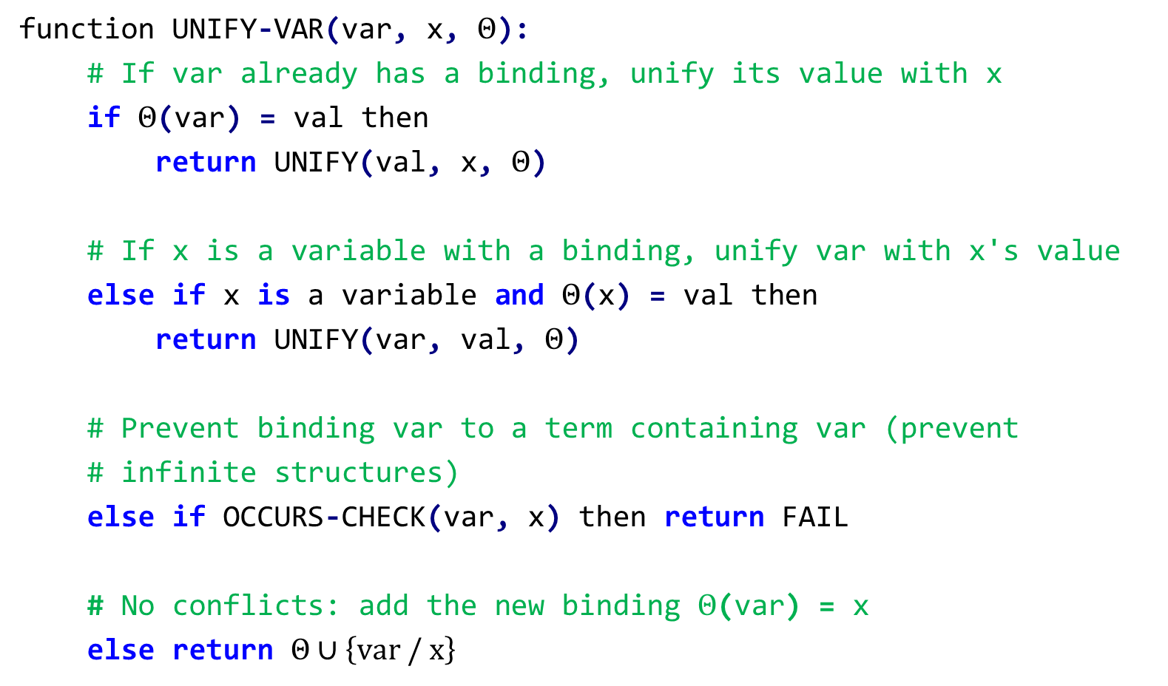
UNIFY-VAR
function UNIFY-VAR(var, x, $Θ$):
# If var already has a binding, unify its value with x
if $Θ$(var) = val then
return UNIFY(val, x, $Θ$)
# If x is a variable with a binding, unify var with x's value
else if x is a variable and $Θ$(x) = val then
return UNIFY(var, val, $Θ$)
# Prevent binding var to a term containing var (prevent
# infinite structures)
else if OCCURS-CHECK(var, x) then return FAIL
# No conflicts: add the new binding $Θ$(var) = x
else return $Θ∪\left\{var / x\right\}$
Goal: Given a variable and an expression, find a substitution that makes them identical, following any existing bindings and preventing circular references.

Slide 26
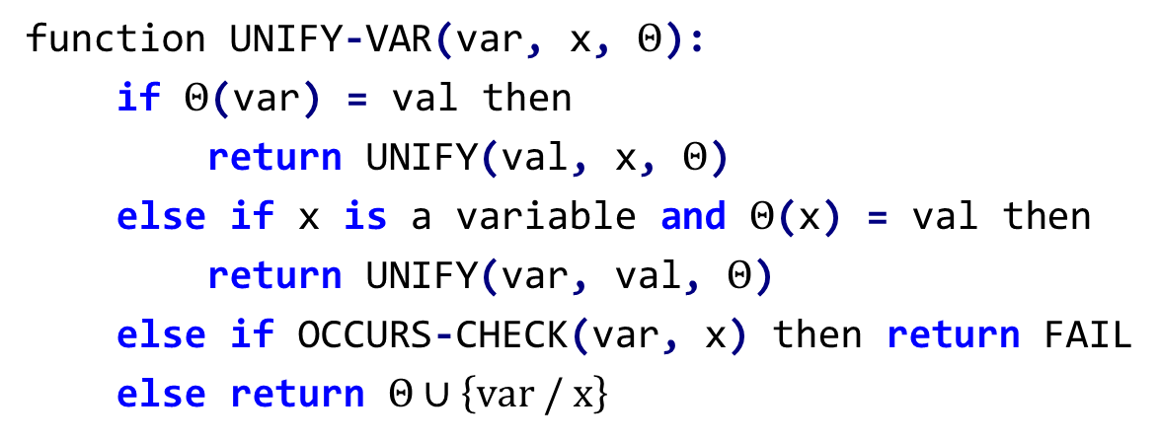
UNIFY-VAR Examples
Simple variable binding
UNIFY-VAR(x, Alice, {})
→
{x/Alice}
Following existing bindings
UNIFY-VAR(y, x, {x/Alice})
→
{x/Alice, y/Alice}
Variable already bound
UNIFY-VAR(x, Bob, {x/Alice})
→
FAIL
Binding to a complex term
UNIFY-VAR(z, MotherOf(Alice), {})
→
{z/MotherOf(Alice)}
Chain of variable bindings
UNIFY-VAR(z, y, {x/Alice, y/x})
→
{x/Alice, y/x, z/Alice}
Occurs check violation
UNIFY-VAR(x, Parent(y, x), {y/Alice})
→
FAIL

Slide 27
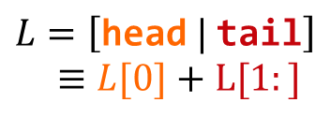
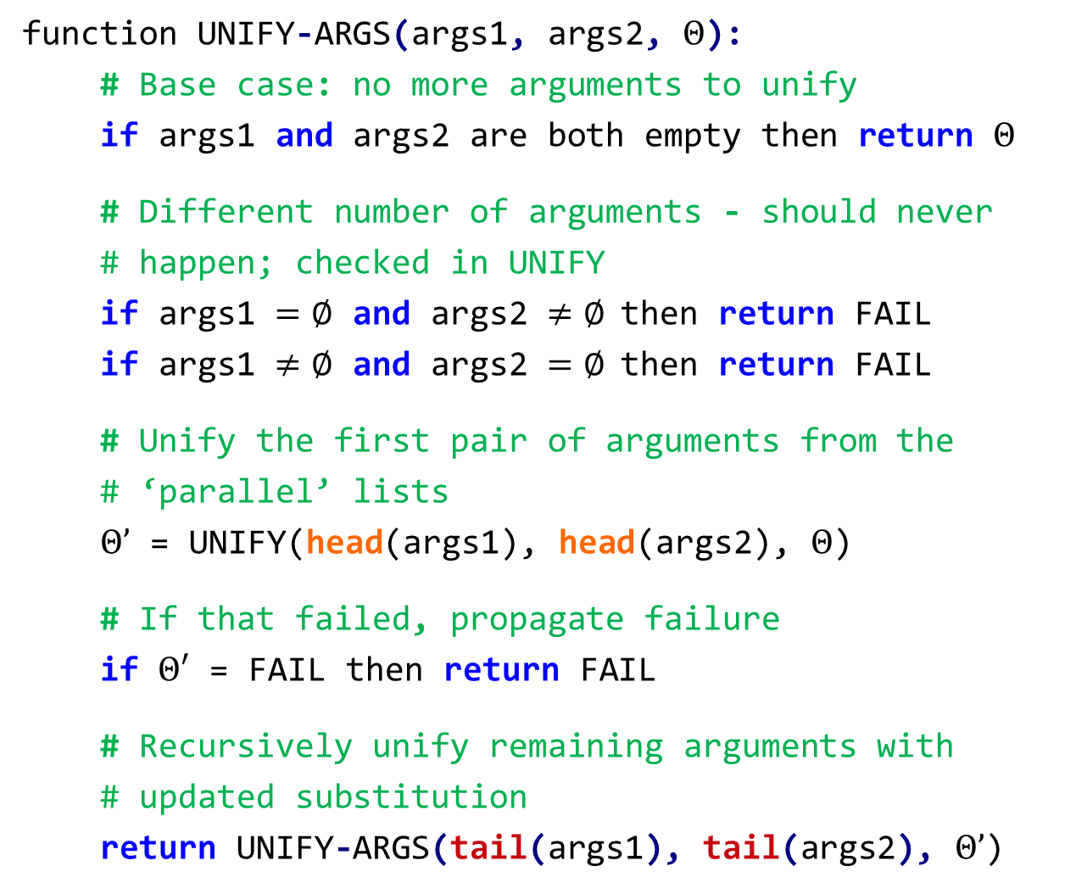
UNIFY-ARGS
function UNIFY-ARGS(args1, args2, $Θ$):
# Base case: no more arguments to unify
if args1 and args2 are both empty then return $Θ$
# Different number of arguments - should never
# happen; checked in UNIFY
if args1 $=∅$ and args2 $≠∅$then return FAIL
if args1 $≠∅$ and args2 $=∅$then return FAIL
# Unify the first pair of arguments from the
# ‘parallel’ lists
$Θ’$ = UNIFY(head(args1), head(args2), $Θ$)
# If that failed, propagate failure
if $Θ′$ = FAIL then return FAIL
# Recursively unify remaining arguments with
# updated substitution
return UNIFY-ARGS(tail(args1), tail(args2), $Θ’$)
Goal: Given two parallel lists, unify arguments one at a time (left to right), threading the substitution through each step.
$$L=\left[\text{head} | \text{tail}\right]$$
$≡L[0]+L[1:]$

Slide 28
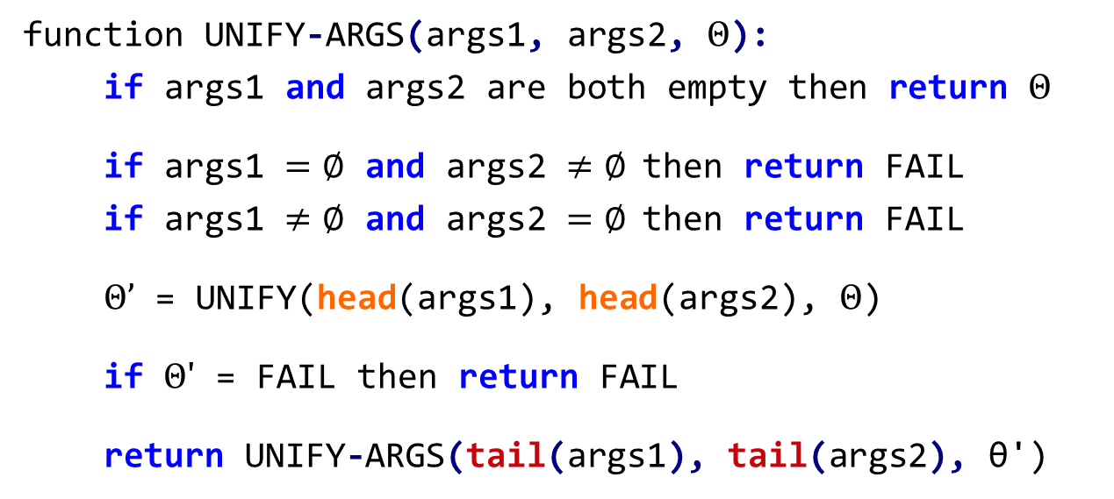
UNIFY-ARGS Examples I
UNIFY-ARGS([Alice, x], [y, Bob], {})
UNIFY(Alice, y, {}) → {y/Alice}
UNIFY-ARGS([x], [Bob], {y/Alice})
UNIFY(x, Bob, {y/Alice})
→
{y/Alice, x/Bob}
UNIFY-ARGS([x, x], [Alice, y], {})
UNIFY(x, Alice, {}) → {x/Alice}
UNIFY-ARGS([x], [y], {x/Alice})
UNIFY(x, y, {x/Alice})
→
{x/Alice, y/Alice}

Slide 29
UNIFY-ARGS Examples II
UNIFY-ARGS([Alice, x], [Bob, y], {})
UNIFY(Alice, Bob, {})
→
FAIL
UNIFY-ARGS([x, MotherOf(y)],
[Alice, MotherOf(Bob)], {})
UNIFY(x, Alice, {}) → {x/Alice}
UNIFY-ARGS([MotherOf(y)], [MotherOf(Bob)], {x/Alice})
UNIFY(MotherOf(y), MotherOf(Bob), {x/Alice})
UNIFY-ARGS([y], [Bob], {x/Alice})
UNIFY(y, Bob, {x/Alice})
→
{y/Alice, x/Bob}

Slide 30
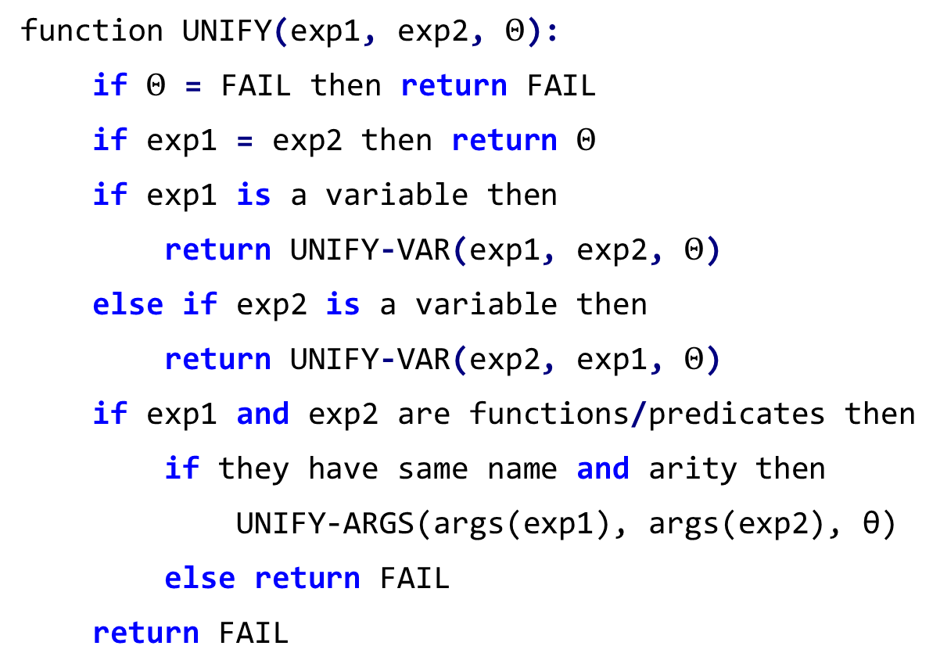
UNIFY Example
UNIFY(Parent(John, MotherOf(x)),
Parent(y, MotherOf(Bob)), {})
Same predicate and arity
UNIFY-ARGS([John, MotherOf(x)],
[y, MotherOf(Bob)], {})
UNIFY(John, y, {}) → {y/John}
UNIFY(MotherOf(x), MotherOf(Bob), {y/John})
UNIFY-ARGS([x], [Bob], {y/John})
UNIFY(x, Bob, {y/John})
→
{y/John, x/Bob}

Slide 31
Inference in First-Order Logic

Slide 32
Toward Inference
What Has Been Built:
  Syntax: How to write statements in FOL.
  Unification: How to make expressions match.
Why does matching matter?
  → Because rules are general but facts are specific!
What is missing?
  → How to derive new knowledge!
Goal: Automated Reasoning
Input: Facts and rules in a knowledge base
Output: Answers to queries (true / false or variable bindings)
Process:
  Find a rule that might apply to the query.
  Use unification to match the rule's premises with known facts.
  Apply the same substitution to the rule's conclusion.
  Derive new knowledge and repeat as needed.
Knowledge Base:
  Student(Alice)
  ∀x Student(x) ⇒ TakesCourses(x)
  ∀x TakesCourses(x) ⇒ NeedsCoffee(x)
Query: NeedsCoffee(Alice)?
Yes.
We need formal rules for deriving new knowledge, using quantifiers, and making valid substitutions.

Slide 33

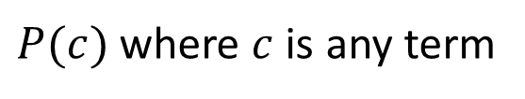
Inference Rules: Universal Instantiation
Rule: If something is true for all $x$, then it is true for any specific instance.
Formally:
  Given:
  Infer:
  $$∀x P(x)$$
  $P(c)$ where $c$ is any term
KB:
  Student(Alice)
  Student(Bob)
  Student(FatherOf(Charlie))
  ∀x Student(x) ⇒ Person(x)
Using universal instantiation, we can infer:
  Student(Alice) ⇒ Person(Alice)
  Student(Bob) ⇒ Person(Bob)
  Student(FatherOf(Charlie)) ⇒ Person(FatherOf(Charlie))

Slide 34

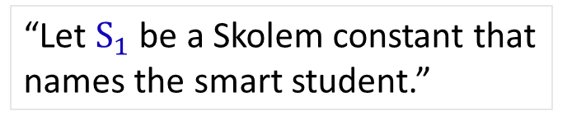
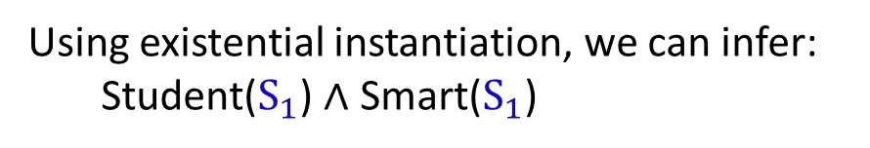
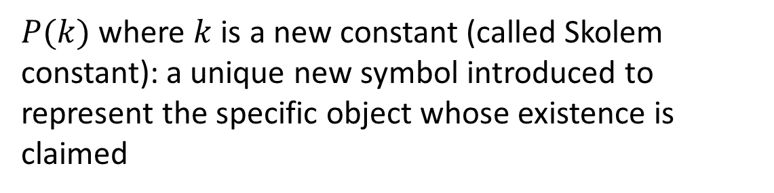
Inference Rules: Existential Instantiation
Rule: If we know something with property $P$ exists, we can introduce a new constant to refer to it.
Given:
Infer:
  $$∃x P(x)$$
Formally
  $P(k)$ where $k$ is a new constant (called Skolem constant): a unique new symbol introduced to represent the specific object whose existence is claimed
KB:
  ∃x Student(x) ∧ Smart(x)
Using existential instantiation, we can infer:
  Student($S_{1}$) ∧ Smart($S_{1}$)
“There exists a student who is smart”
“Let $S_{1}$ be a Skolem constant that names the smart student.”
We don't know which student is smart, only that at least one exists so we need to use a new symbol not used elsewhere in the KB.

Slide 35
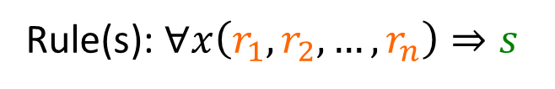
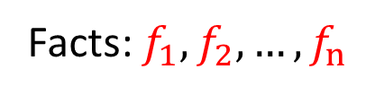


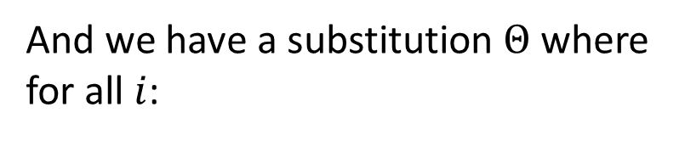
Generalized Modus Ponens (GMP)
Universal Instantiation + Unification + Modus Ponens = Generalized Modus Ponens
If we can unify facts with the premises of a rule, we can infer the conclusion with that same substitution.
Suppose we have:
Knowledge Base:
And we have a substitution $Θ$ where for all $i$:
Facts: $f_{1},f_{2},…,f_{n}$
$$f_{1}=Θ\left(r_{i}\right)$$
Rule(s): $∀x\left(r_{1},r_{2},…,r_{n}\right)⇒s$
We can infer:
$$Θ\left(s\right)$$

Slide 36

Example of Generalized Modus Ponens
KB:
  Teaches(Alvin, CSC343, Spring2026)
  Enrolled(Alice, CSC343, Spring2026)
Rule(s):
  ∀prof ∀student ∀course ∀semester (Teaches(prof, course, semester) ∧ Enrolled(student, course, semester))
  ⇒ InClass(student, prof, course)
Match premises with facts using $Θ$:
  $Θ$(Teaches(prof, course, semester) ) = Teaches(Alvin, CSC343, Spring2026)
where $Θ$(prof) = Alvin, $Θ$(course) = CSC343, and $Θ$(semester) = Spring2026
  $Θ$(Enrolled(student, course, semester)) = Enrolled(Alice, CSC343, Spring2026))
where $Θ$(student) = Alice, $Θ$(course) = CSC343, and $Θ$(semester) = Spring2026
So by generalized Modus Ponens, we have:
  $Θ$(InClass(student, prof, course)) = InClass(Alice, Alvin, CSC343)

Slide 37
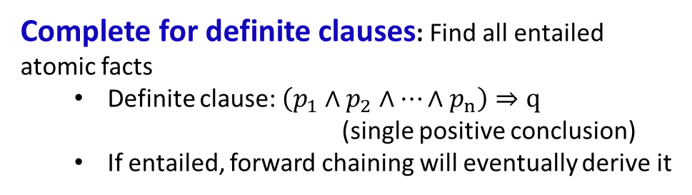
Forward Chaining in FOL
Start with initial facts in KB
Find a rule whose premises match facts (using unification)
Apply GMP to derive the conclusion
Add the new fact to KB
Repeat until goal is derived or no new facts can be added
This is the same algorithm as in propositional logic, except here we use unification and GMP to derive new facts in FOL.
Properties
Sound: Everything derived is entailed by the KB
  Forward chaining only derives logical consequences
  No false conclusions from true premises
Exhaustive: Derives all entailed facts
  Continues until no new inferences
  Guarantees nothing is missed
Complete for definite clauses: Find all entailed atomic facts
  Definite clause: $\left(p_{1}∧p_{2}∧…∧p_{n}\right)⇒q$
            (single positive conclusion)
  If entailed, forward chaining will eventually derive it
May derive irrelevant facts: the “Shotgun approach”
  Produces facts unrelated to your query
  Inefficient for large KBs

Slide 38
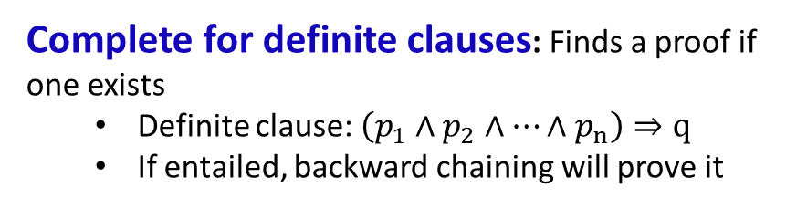
Backward Chaining in FOL
Check if goal is already a fact in KB
Find rules whose conclusions could match the goal
Use UNIFY to match the rule's conclusion with the goal
If unification succeeds, apply θ to the rule's premises to get specific subgoals
Recursively apply backward chaining to prove each subgoal
If all subgoals are proven, return success; otherwise try next rule
If no rule succeeds, return failure
Same algorithm as in propositional logic, except here we use unification to work backwards from goals to facts in FOL.
Properties
Complete for definite clauses: Finds a proof if one exists
  Definite clause: $\left(p_{1}∧p_{2}∧…∧p_{n}\right)⇒q$
  If entailed, backward chaining will prove it
Goal-Directed: More efficient than forward chaining
Explores only facts relevant to the query
Avoids irrelevant derivations
Sound: Proves only entailed goals
  No false conclusions
  Every step is logically valid
Prolog-based:
  Prolog uses backward chaining with depth-first search
  Ideal for answering queries

Slide 39




Example: Backward Chaining in FOL
KB:
  Student(Alice)
  Takes(Alice, CSC343)
  ∀x (Student(x) ∧ Takes(x, CSC343)) ⇒ Smart(x)
Query: Smart(Alice)
In KB.
In KB.
$$Student\left(Alice\right)$$
$$Takes\left(Alice, CSC343\right)$$
Prove subgoals
$$Student\left(Alice\right)∧Takes\left(Alice, CSC343\right)$$
Apply $Θ$ to premises to get subgoals.
$Θ=UNIFY\left(Smart\left(x\right),Smart\left(Alice\right)\right)$ = { $x$/Alice }
UNIFY goal with rule conclusion:
∀x (Student(x) ∧ Takes(x, CSC343)) ⇒ Smart(x)
Find matching rule: conclusion could match the goal
Smart(Alice)

Slide 40
Inference in Prolog

Slide 41
Backtracking
If we reach a point where a goal cannot be matched, or the body of a rule cannot be matched, we backtrack to the last (most recent) spot where a choice of matching a particular fact or rule was made.
We then try to match a different fact or rule. If this cannot be done, we go back to the next previous place where a choice was made and try a different match there.
We try alternatives until we are able to solve all the goals in our query or until all possible choices have been tried and found to fail.
If this happens, we answer “no” the query can’t be solved.
As we try to match facts and rules we try them in their order of definition.
Depth-first search.

Slide 42
Backtracking Example
Our database:
Query:
grandMotherOf(X,GM) :- motherOf(X,M), motherOf(M,GM).
grandMotherOf(X,GM) :- fatherOf(X,F), motherOf(F,GM).
fatherOf(tom,dick).
fatherOf(dick,harry).
fatherOf(jane,harry).
motherOf(tom,judy).
motherOf(dick,mary).
motherOf(jane,mary).
?- grandMotherOf(tom, GM).
We try the first grandMotherOf rule first.
This forces X = tom.
We have to solve:
motherOf(tom,M), motherOf(M,GM).
This forces M = judy.
No other motherOf rule can solve motherOf(tom,M).
motherOf(judy,GM)
None of the motherOf rules match this goal, so we backtrack.

Slide 43
Backtracking Example (continued)
grandMotherOf(X,GM) :- motherOf(X,M), motherOf(M,GM).
grandMotherOf(X,GM) :- fatherOf(X,F), motherOf(F,GM).
fatherOf(tom,dick).
fatherOf(dick,harry).
fatherOf(jane,harry).
motherOf(tom,judy).
motherOf(dick,mary).
motherOf(jane,mary).
Query:
?- grandMotherOf(tom, GM).
We try the second grandMotherOf rule.
This forces X = tom.
We have to solve:
fatherOf(tom,F), motherOf(F,GM).
We can match:
fatherOf(tom,dick).
motherOf(dick,GM)
We can match:
motherOf(dick, mary).
This forces F = dick.
We have matched all our goals, so we know the query is true, with GM = mary.
None of the fatherOf rules match this goal, so we backtrack.
No other motherOf rule can solve motherOf(dick, GM).

Slide 44
Query Overview
motherOf(jane, mary)
motherOf(tom,judy)
fatherOf(jane,harry)
motherOf(tom,judy)
motherOf(dick, mary)
motherOf(dick, mary)
fatherOf(dick, harry)
motherOf(dick, mary)
motherOf(tom, judy)
motherOf(jane, mary)
fatherOf(tom, dick)
motherOf(jane, mary)
X= ,
M=
X= ,
M= ,
GM=
X= ,
F=
X= ,
F=
motherOf(X, M), motherOf(M, GM)
fatherOf(X, F), motherOf(F, GM)
X= ,
GM=
X= ,
GM=
grandMotherOf(X, GM)

Slide 45
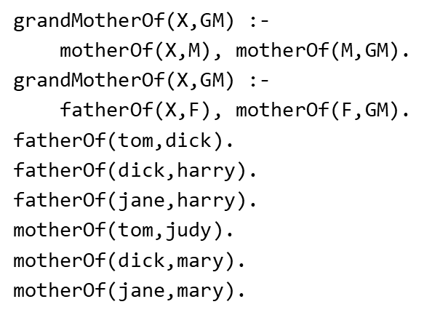
Visualizing Prolog Query Search I
motherOf(tom,judy)
motherOf(dick, mary)
motherOf(tom, judy)
motherOf(jane, mary)
X=tom,
M=judy
X=tom,
M=judy,
GM=?
motherOf(X, M), motherOf(M, GM)
X=?,
GM=?
grandMotherOf(X, GM)

Slide 46
Visualizing Prolog Query Search II
motherOf(tom,judy)
motherOf(dick, mary)
motherOf(dick, mary)
motherOf(jane, mary)
X=dick,
M=mary
X=dick,
M=mary,
GM=?
motherOf(X, M), motherOf(M, GM)
X= ,
GM=
grandMotherOf(X, GM)

Slide 47
Visualizing Prolog Query Search III
motherOf(jane, mary)
motherOf(tom,judy)
motherOf(dick, mary)
motherOf(jane, mary)
X=jane,
M=mary
X=jane,
M=mary,
GM=
motherOf(X, M), motherOf(M, GM)
X= ,
GM=
grandMotherOf(X, GM)

Slide 48
Visualizing Prolog Query Search IV: New Rule
motherOf(jane, mary)
motherOf(tom,judy)
fatherOf(jane,harry)
motherOf(tom,judy)
motherOf(dick, mary)
motherOf(dick, mary)
fatherOf(dick, harry)
motherOf(dick, mary)
motherOf(tom, judy)
motherOf(jane, mary)
fatherOf(tom, dick)
motherOf(jane, mary)
X= ,
M=
X= ,
M= ,
GM=
X= ,
F=
X= ,
F= ,
GM=
motherOf(X, M), motherOf(M, GM)
fatherOf(X, F), motherOf(F, GM)
X= ,
GM=
X= ,
GM=
grandMotherOf(X, GM)

Slide 49
Visualizing Prolog Query Search V
motherOf(tom,judy)
motherOf(dick, mary)
fatherOf(tom, dick)
X=tom,
F=dick
X=tom,
F=dick,
GM=?
GM=mary
fatherOf(X, F), motherOf(F, GM)
X=?,
GM=?
X=tom,
GM=mary
grandMotherOf(X, GM)

Slide 50
Visualizing Prolog Query Search VI
fatherOf(tom, dick)
motherOf(jane, mary)
X=tom,
F=dick
X=tom,
F=dick,
GM=?
fatherOf(X, F), motherOf(F, GM)
X=?,
GM=?
grandMotherOf(X, GM)

Slide 51
Visualizing Prolog Query Search VII
motherOf(tom,judy)
fatherOf(dick, harry)
motherOf(dick, mary)
motherOf(jane, mary)
X=dick,
F=harry
X=dick,
F=harry
GM=?
fatherOf(X, F), motherOf(F, GM)
X= ,
GM=
grandMotherOf(X, GM)

Slide 52
Visualizing Prolog Query Search VIII
fatherOf(jane,harry)
motherOf(tom,judy)
motherOf(dick, mary)
motherOf(jane, mary)
X=jane,
F=harry
X=jane,
F=harry
GM=?
fatherOf(X, F), motherOf(F, GM)
X= ,
GM=
grandMotherOf(X, GM)

